Slide 1



Slide 2


Write custom native module for React Native
Mr. NGUYEN ANH TUAN
Tech Leader
AgileTech
Notes:
Hello everyone. My name is XYZ and I’m a ABC. I’m excited to introduce you to React and React Native that you can use to build web apps and native apps. During this talk you’ll get started on how to use them.

Slide 3
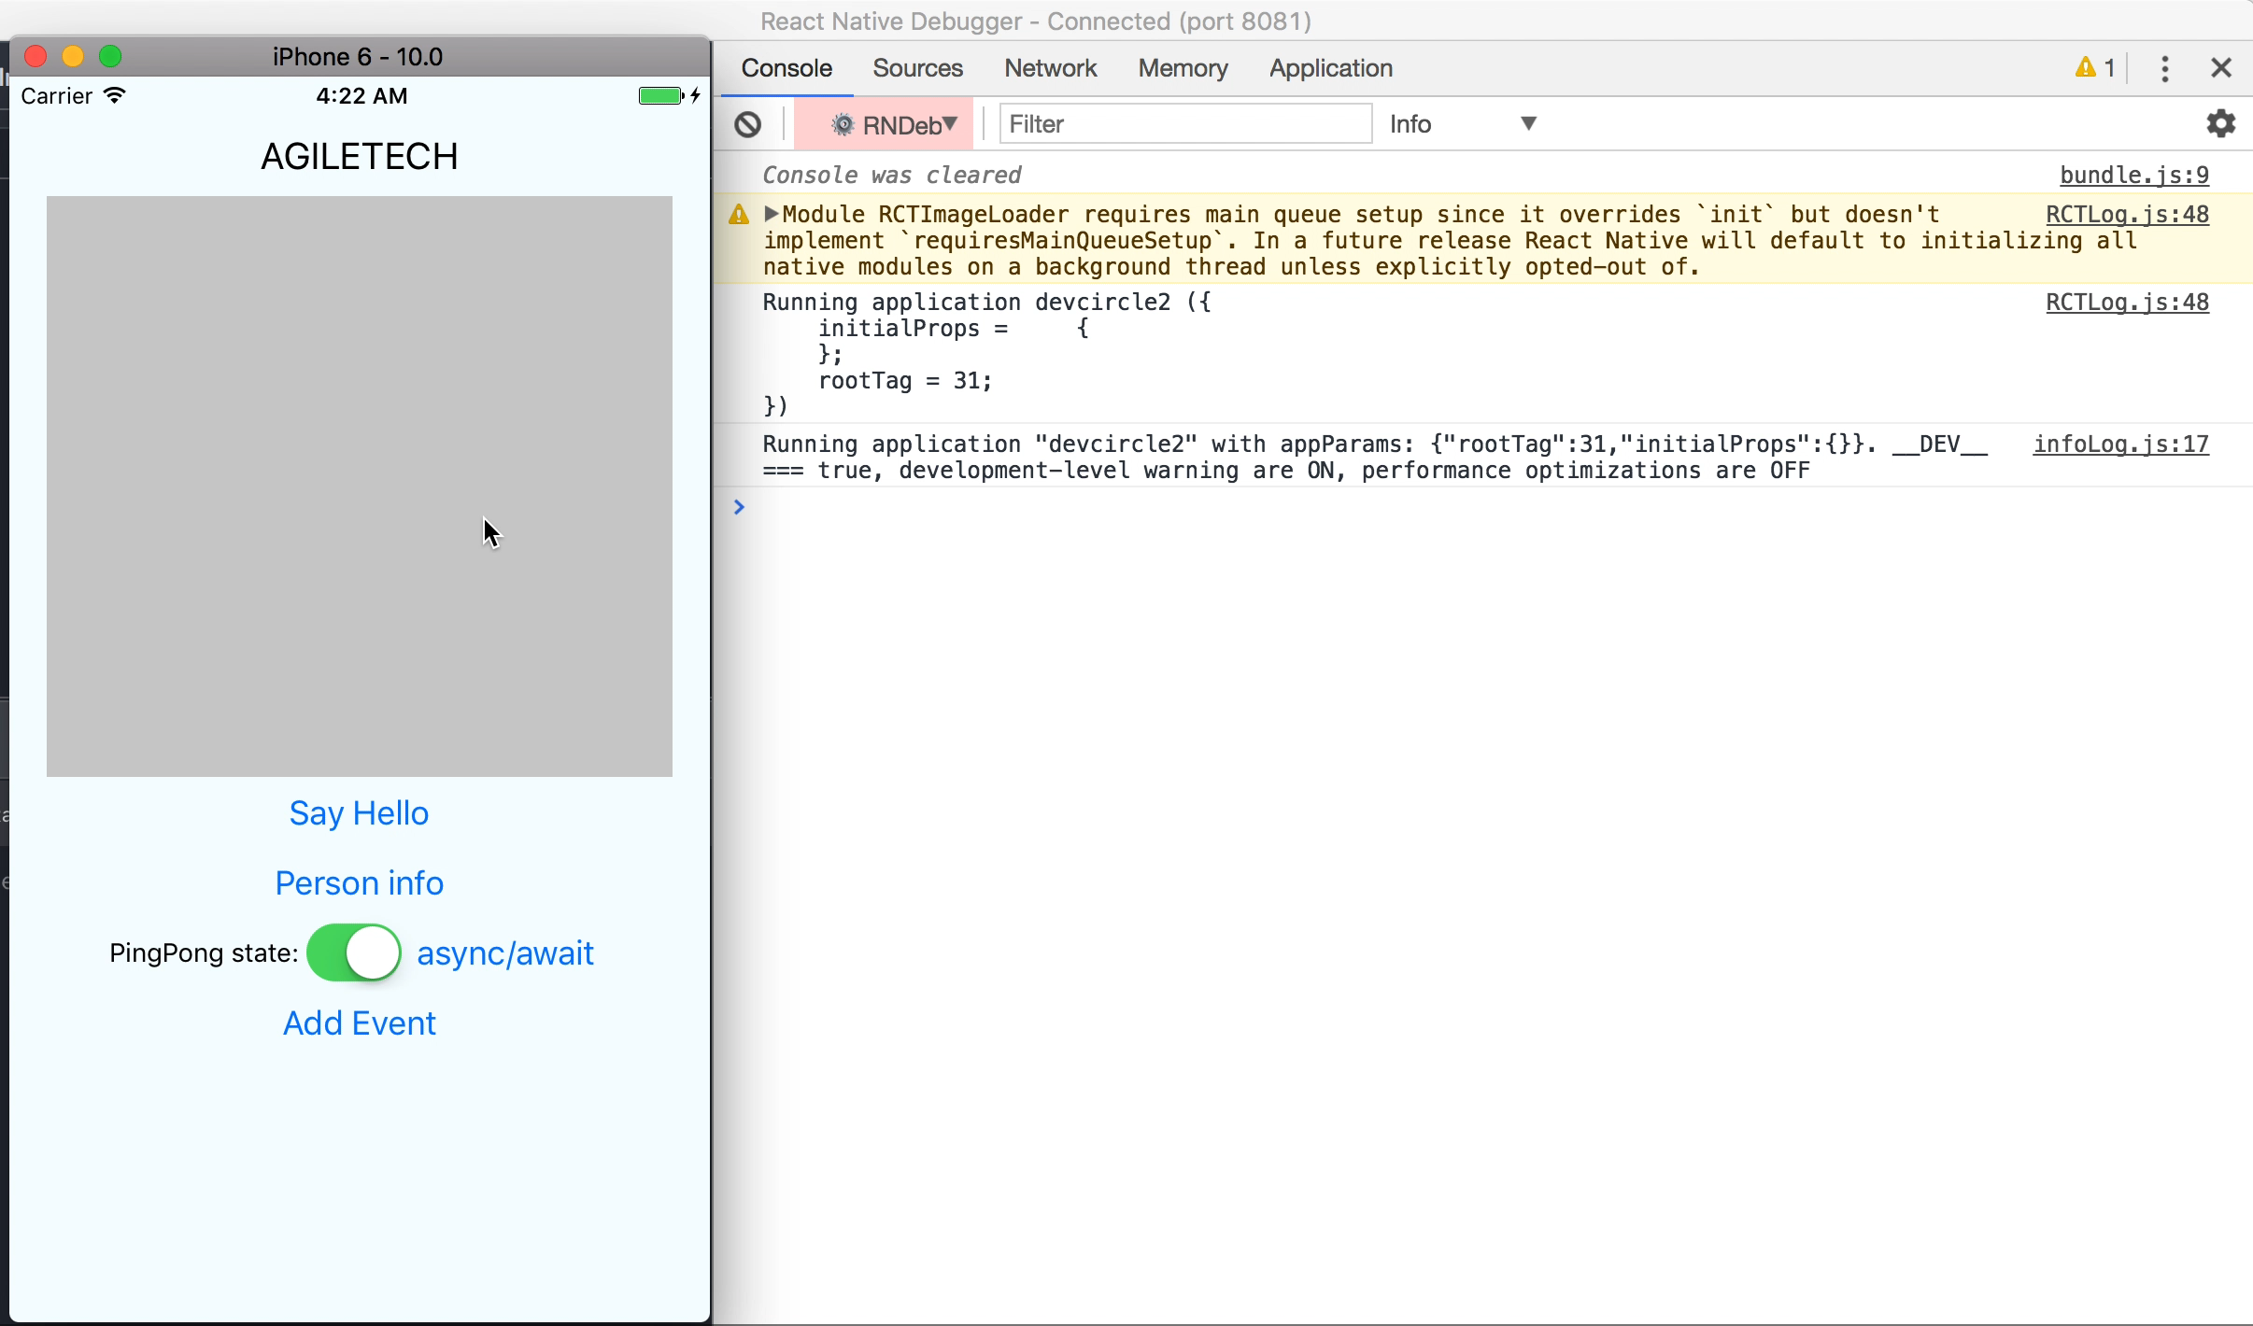
Introduction

Slide 4

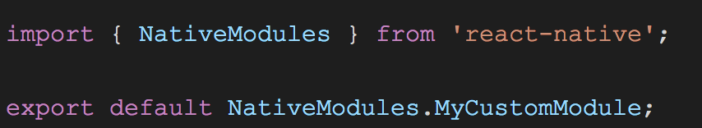
What?
Working with native side. Use more advance features of OS
iOS
Android

Slide 5
Why?
Each Operating System have it own technology
Let native handle heavy process
Some required native module not available
And???

Slide 6
How?
Android (java, kotlin)
iOS (Objective-C, Swift)

Slide 7
Npm market
npm install -g react-native-create-library
react-native-create-library MyLibrary --package-identifier vn.agiletech.mylibrary
cd MyLibrary
npm login
npm publish

Slide 8

Practice
Code Example
More information
https://github.com/anhtuank7c/react-native-demo-custom
https://github.com/anhtuank7c/fbdevcirclehanoi2
Notes:
To find out more and explore our open source offerings, check out this link.

Slide 9

Thank You
Notes:
You should now more insight into why we built React and React Native. There’s a lot more to learn by visiting the project websites and getting involved with the community. The hope is that we’ll see you build some great projects with this tech and other projects we’ve shared.
Thank You!!

